Slide 1
Machine Translation

Slide 2
Sequence to sequence models
These types of problems, where you put some text into your model and get some other text out of it, are known as sequence to sequence or string transduction problems.
The general task of sequence to sequence modelling is at the heart of some of the most difficult tasks in NLP, including:
Text summarization
Text simplification
Question answering
Chatbots
Machine translation

Slide 3
Machine Translation (MT)
Machine translation is the task of automatically converting source text in one language to text in another language.
Given a sequence of text in a source language, there is no one single best translation of that text to another language. This is because of the natural ambiguity and flexibility of human language.
French: Le chat est sur le tapis
Reference 1: The cat is on the mat. (Translation by human)
Reference 2: There is a cat on the mat. (Translation by another human)
Multiple translations possible.

Slide 4
Machine Translation
Statistical Machine Translation
use of statistical models that learn to translate text from a source language to a target language gives a large corpus of examples.
The approach is data-driven, requiring only a corpus of examples with both source and target language text. This means linguists are not longer required to specify the rules of translation.
Neural Machine Translation
Neural machine translation, or NMT for short, is the use of neural network models to learn a statistical model for machine translation.
The key benefit to the approach is that a single system can be trained directly on source and target text, no longer requiring the pipeline of specialized systems used in statistical machine learning.

Slide 5
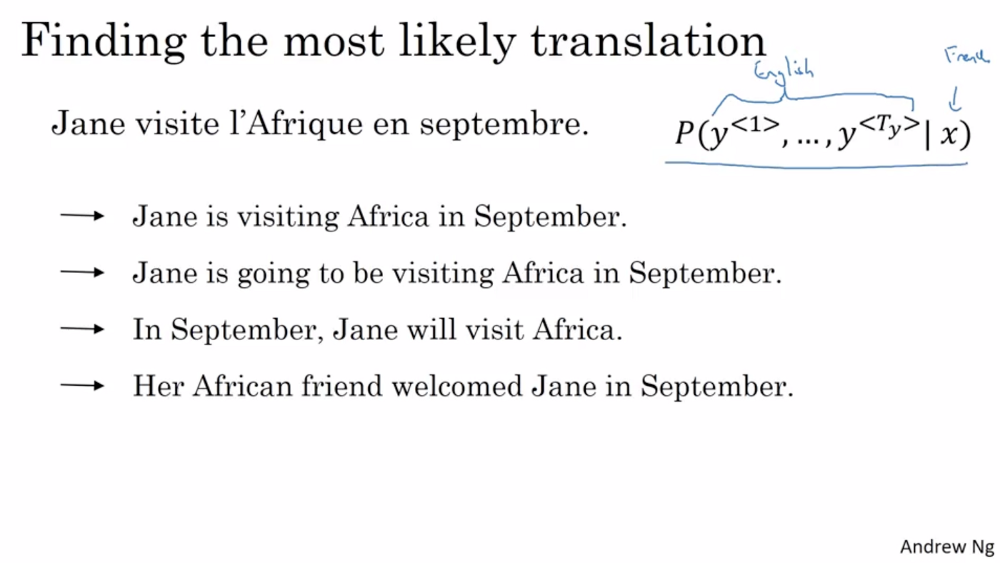
Beam Search and Width
When we use RNN architecture for translation we need a way to find the best combination of words for a translation. The most common algorithm for doing this is called Beam Search algorithm and has a parameter called B, which is called the Beam Width.

Slide 6
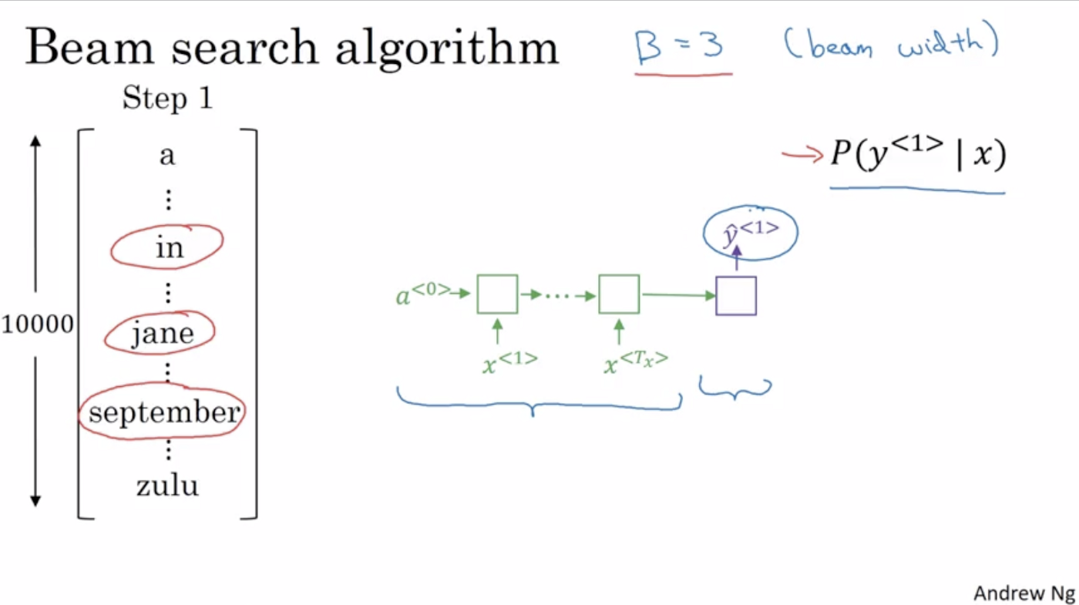
Beam Search and Width
With beam width 3, beam search will consider three words to choose from for the first word. So, in order to perform this first step of Beam search, we run the input French sentence through the encoder network and then the first in the decoder network is a softmax output with overall 10,000 possibilities and we will store the top 3 words because of beam width 3.

Slide 7
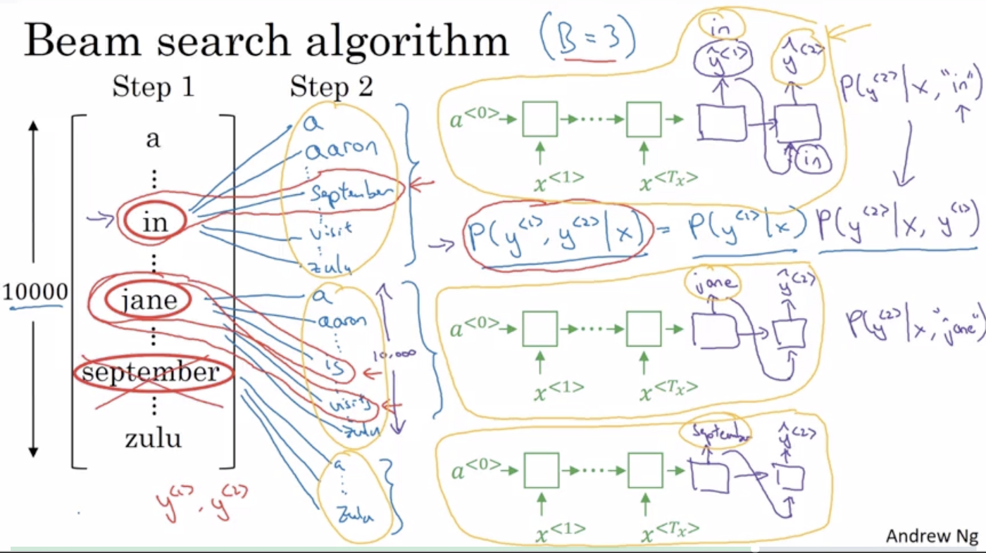
Beam Search and Width
So for this second step of beam search since we have 10,000 words in our vocabulary, we would end up considering three times 10000 or thirty thousand possibilities and then pick the top three.

Slide 8
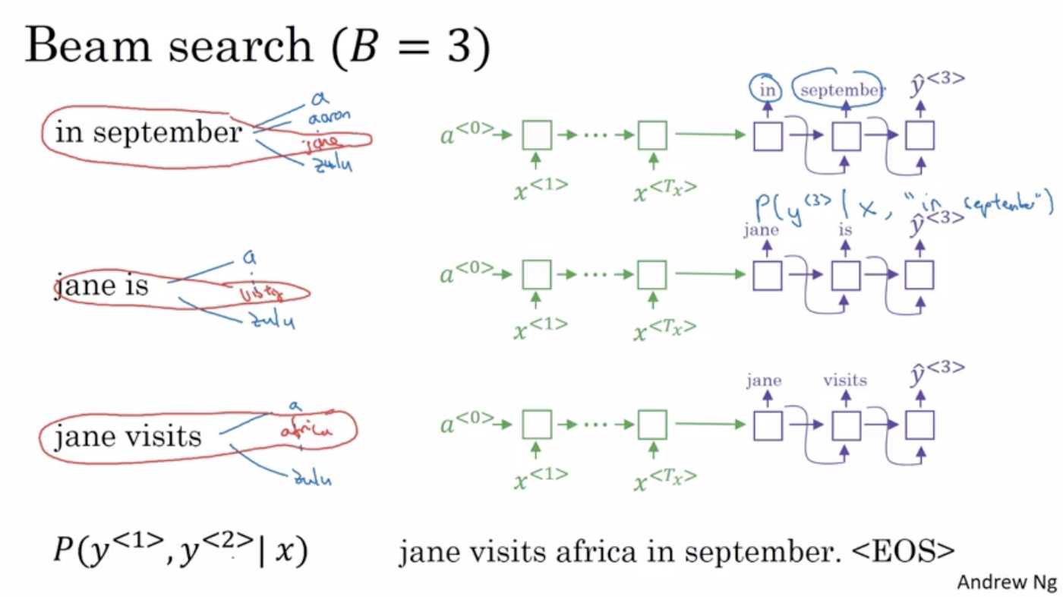
Beam Search and Width
And the outcome of this process will be that adding one word at a time until Beam search will decide EOS as the best next symbol.
if the beam width was 1, then this essentially becomes the greedy search algorithm.
Three copies of network (B=3) to find probability of each choices

Slide 9
Evaluating Machine Translation
French: Le chat est sur le tapis
Reference 1: The cat is on the mat. (Translation by human)
Reference 2: There is a cat on the mat. (Translation by another human)
Multiple translations possible.
One of the challenges of machine translation is that how to evaluate a machine translation system quality/accuracy.
Bleu Score: A method for automatically evaluation of machine translation
BLEU was originally developed to measure machine translation

Slide 10
Evaluating Machine Translation
How can I assign a single numerical score to this translation that tells us how “good” it is using only the provided reference sentences and the neural output?
Why do you need a single numerical score?
If we want to use machine learning to build a machine translation system we need a single real number score to put into our loss function.

Slide 11
Bleu Score
BLEU, stands for Bilingual Evaluation, Understudy. (senior actor)
Score is an understudy, could be a substitute for having humans evaluate every output of a machine translation system.
Given by Kishore Papineni, Salim Roukos, Todd Ward, and Wei-Jing Zhu.

Slide 12
Bleu Score
Look at each word in the output sentence
Assign it a score of 1 if it shows up in any of the reference sentences
Assign 0 if it doesn’t.
To normalize that count so that it’s always between 0 and 1, you can divide the number of words that showed up in one of the reference translations by the total number of words in the output sentence.
This gives us a measure called unigram precision.

Slide 13
Bleu Score on unigram
French: Le chat est sur le tapis
Reference 1: The cat is on the mat. (Translation by human)
Reference 2: There is a cat on the mat. (Translation by another human)
MT Output: The the the the the the the.
Word: The
Precision: 7/7 the appears in both references /count of unigram
Modified Precision:2/7 max times word appeared in sentences/count unigram
Words precision are counted individually
Blue score: word as well as pairs (bigram, trigram)

Slide 14
Bleu Score on bigram
French: Le chat est sur le tapis
Reference 1: The cat is on the mat. (Translation by human)
Reference 2: There is a cat on the mat. (Translation by another human)
MT Output: The cat the cat on the mat.
Bigrams: Count: Count clip(max count in ref):
the cat: 2 1
cat the: 1 0
cat on: 1 1
on the: 1 1
the mat: 1 1
modified precision: sum of count clip/total bigram words=4/6

Slide 15
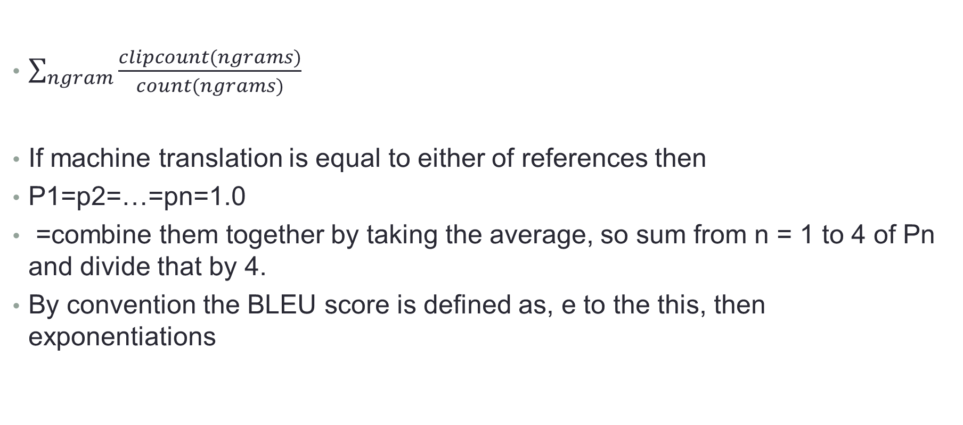
Blue Score on ngrams
$\sum_{ngram}{\frac{clipcount(ngrams)}{count(ngrams)}}$
If machine translation is equal to either of references then
P1=p2=…=pn=1.0
=combine them together by taking the average, so sum from n = 1 to 4 of Pn and divide that by 4.
By convention the BLEU score is defined as, e to the this, then exponentiations

Slide 16
Brevity Penalty
If we translate very short sentences there is easier to get high precision
One way of getting around this is by multiplying the score we have so far by a measure that penalizes sentences that are shorter than any of our reference translations. We can do this by comparing it to the length of the reference sentence that it the closest in length. This is the brevity penalty.
If our output is as long or longer than any reference sentence, the penalty is 1. Since we’re multiplying our score by it, that doesn’t change the final output.
BP = { 1 if MT_output_length>reference_output_length
exp(1-MT_output_lenght/reference_output_length) otherwise

Slide 17
BLEU Strengths and Drawbacks
Strengths:
It’s fast and easy to calculate, especially compared to having human translators rate model output.
It’s ubiquitous. This makes it easy to compare your model to benchmarks on the same task.
Drawbacks:
It doesn’t consider meaning
It doesn’t directly consider sentence structure
It doesn’t handle morphologically(smallest unit like s in cats) rich languages well
It doesn’t map well to human judgments

Slide 18

Attention Mechanism in Neural Networks
Most powerful concepts in the deep learning
based on a common-sense intuition that we “attend to” a certain part when processing a large amount of information.

Slide 19
Encoder-Decoder Model
Encoder-It accepts a single element of the input sequence at each time step, process it, collects information for that element and propagates it forward.
The encoder is basically LSTM/GRU cell.
An encoder takes the input sequence and encapsulates the information as the internal state vectors. It contains information about the entire input sequence to help the decoder make accurate predictions.
Outputs of the encoder are rejected and only internal states are used
Decoder- given the entire sentence, it predicts an output at each time step.

Slide 20
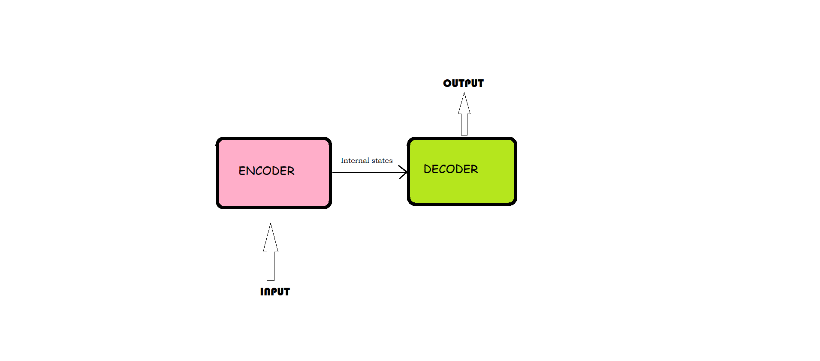
Attention Model
The attention mechanism emerged as an improvement over the encoder decoder-based.
The encoder-decoder model is a way of using recurrent neural networks for sequence-to-sequence prediction problems.

Slide 21
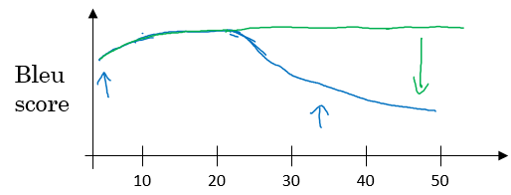
Attention Model
Sequence to sequence Model & Encoder Decoder Model
improve the performance of Neural Machine Translation (NMT) by selectively focusing on sub-parts of the sentence during translation.
Useful specially for longer sequences
Attention Model
Sentence length

Slide 22
Attention Model
it seems somewhat unreasonable to assume that we can encode all information about a potentially very long sentence into a single vector and then have the decoder produce a good translation based on only that. Let’s say your source sentence is 50 words long.
With an attention mechanism we no longer try encode the full source sentence into a fixed-length vector. Rather, we allow the decoder to “attend” to different parts of the source sentence at each step of the output generation.
Importantly, we let the model learn what to attend to based on the input sentence and what it has produced so far.
The important part is that each decoder output word yt now depends on a weighted combination of all the input states, not just the last state.

Slide 23
Applications
Healthcare analytics : Choi et al. (2016)
Speech recognition: Chorowski et al. (2015)
Graph attention networks: Velickovic´ et al. (2018)
Recommender systems: Seo et al. (2017) Tay et al. (2018)
Self-driving cars: Kim and Canny (2017)
Natural language processing (NLP)
Image processing

Slide 24
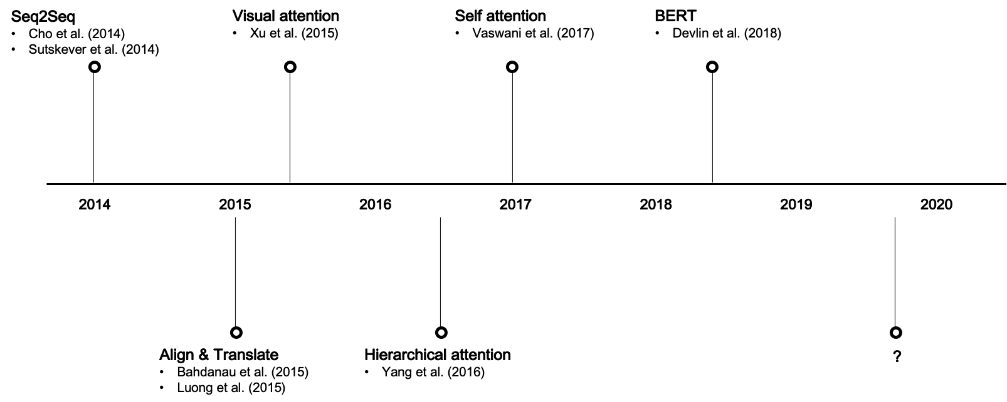
Attention Model
Notes:
Seq2Seq, or RNN Encoder-Decoder (Cho et al. (2014), Sutskever et al. (2014))
Alignment models (Bahdanau et al. (2015), Luong et al. (2015))
Visual attention (Xu et al. (2015))
Hierarchical attention (Yang et al. (2016))
Transformer (Vaswani et al. (2017))
BERT (Devlin et al. 2018)

Slide 25
Sequence to sequence (Seq2Seq) architecture for machine translation
Seq2Seq is a two-part deep learning architecture to map sequence inputs into sequence outputs. It was initially proposed for the machine translation task, but can be applied for other sequence-to-sequence mapping tasks such as captioning and question retrieval.
Cho et al. (2014) and Sutskever et al. (2014) indepedently proposed similar deep learning architectures comprising two recurrent neural networks (RNN), namely encoder and decoder.
.

Slide 26
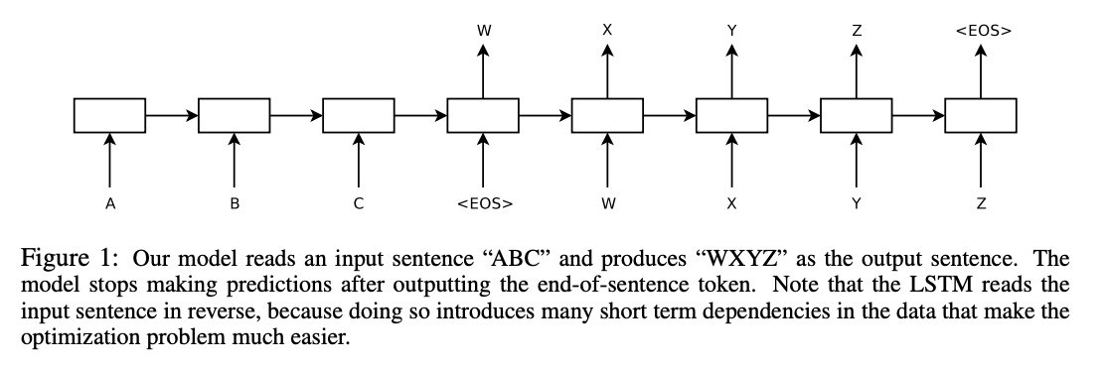
Cho et al. (2014) and Sutskever et al. (2014)
The encoder reads a sequence input with variable lengths, e.g., English words, and the decoder produces a sequence output, e.g., corresponding French words, considering the hidden state from the encoder. The hidden state sends source information from the encoder to the decoder, linking the two. Both the encoder and decoder consist of RNN cells or its variants such as LSTM and GRU

Slide 27
Align & Translate
Problem with vanilla Seq2Seq architecture is that some information might not be captured by a fixed-length vector, i.e., the final hidden state from the encoder (ht).
Problematic when processing long sentences with RNN due to gradient exploding, etc.

Slide 28
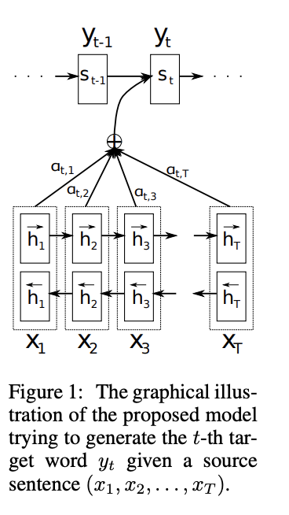
Bahdanau et al. (2015) & Luong et al. (2015)
utilizing a context vector to align the source and target inputs. The context vector preserves information from all hidden states from encoder cells and aligns them with the current target output. By doing so, the model is able to “attend to” a certain part of the source inputs and learn the complex relationship between the source and target better.
outlines various types of attention models to align the source and target.

Slide 29
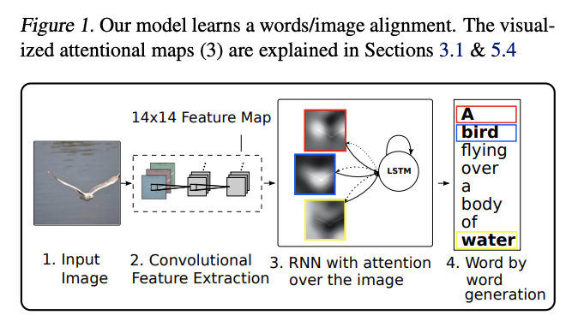
Visual attention
Xu et al. (2015) proposed an attention framework that extends beyond the conventional Seq2Seq architecture. Their framework attempts to align the input image and output word, tackling the image captioning problem.

Slide 30
The Cost of Attention
We need to calculate an attention value for each combination of input and output word. If you have a 50-word input sequence and generate a 50-word output sequence that would be 2500 attention values.
That’s not too bad at word level, but character-level computations and deal with sequences consisting of hundreds of tokens can become prohibitively expensive.
An alternative approach to attention is to use Reinforcement Learning to predict an approximate location to focus to.

